Slide 1
Class IV
Switch case & Functions

Slide 2
What is Switch statement
A switch statement tests the value of a variable and compares it with multiple cases.
Once the case match is found, a block of statements associated with that particular case is executed.

Slide 3
Syntax
The expression can be integer expression or a character expression.
Case labels always end with a colon ( : ). Each of these cases is associated with a block.
The break keyword in each case indicates the end of a particular case. If we do not put the break in each case then even though the specific case is executed, the switch will continue to execute all the cases until the end is reached. This should not happen; hence we always have to put break keyword in each case. Break will terminate the case once it is executed and the control will fall out of the switch.
The default case is an optional one. Whenever the value of test-expression is not matched with any of the cases inside the switch, then the default will be executed. Otherwise, it is not necessary to write default in the switch.
Once the switch is executed the control will go to the statement-x, and the execution of a program will continue.
switch( expression ) {
case value-1:
Block-1;
Break;
case value-2:
Block-2;
Break;
case value-n:
Block-n;
Break;
default:
Block-1;
Break;
}
Statement-x;

Slide 4
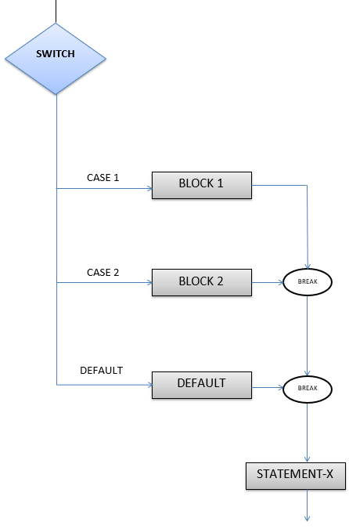
Flow chart Diagram of Switch Case

Slide 5
Example
#include <stdio.h>
int main() {
int num = 8;
switch (num) {
case 7:
printf("Value is 7");
break;
case 8:
printf("Value is 8");
break;
case 9:
printf("Value is 9");
break;
default:
printf("Out of range");
break; }
return 0;
}
#include <stdio.h>
int main() {
int language = 10;
switch (language) {
case 1:
printf("C#\n");
break;
case 2:
printf("C\n");
break;
case 3:
printf("C++\n");
break;
default:
printf("Other programming language\n");
}
}

Slide 6
Rules of a Switch
An expression must always execute to a result.
Case labels must be constants and unique.
Case labels must end with a colon ( : ).
A break keyword must be present in each case.
There can be only one default label.
We can nest multiple switch statements.

Slide 7
C-Functions
A function is a group of statements that together perform a task. Every C program has at least one function, which is main(),
You can divide up your code into separate functions such that each function performs a specific task.
A function declaration tells the compiler about a function's name, return type, and parameters. A function definition provides the actual body of the function.
The C standard library provides numerous built-in functions that your program can call. For example, strcat() to concatenate two strings, memcpy() to copy one memory location to another location, and many more functions.

Slide 8
Defining a Function
return_type function_name( parameter list )
{ body of the function }
Return Type − A function may return a value. The return_type is the data type of the value the function returns. Some functions perform the desired operations without returning a value. In this case, the return_type is the keyword void.
Function Name − This is the actual name of the function. The function name and the parameter list together constitute the function signature.
Parameters − A parameter is like a placeholder. When a function is invoked, you pass a value to the parameter. This value is referred to as actual parameter or argument. The parameter list refers to the type, order, and number of the parameters of a function. Parameters are optional; that is, a function may contain no parameters.
Function Body − The function body contains a collection of statements that define what the function does.

Slide 9
Example
/* function returning the max between two numbers */
int max(int num1, int num2) {
/* local variable declaration */
int result;
if (num1 > num2)
result = num1;
else
result = num2;
return result;
}

Slide 10
Function declaration
A function declaration tells the compiler about a function name and how to call the function.
return_type function_name( parameter list );
Void add(int, char);
int max(int num1, int num2);
int max(int, int);

Slide 11
Calling a Function
When a program calls a function, the program control is transferred to the called function. A called function performs a defined task and when its return statement is executed or when its function-ending closing brace is reached, it returns the program control back to the main program.
To call a function, you simply need to pass the required parameters along with the function name, and if the function returns a value, then you can store the returned value

Slide 12
Example
#include <stdio.h>
/* function declaration */
int max(int num1, int num2);
int main () {
/* local variable definition */
int a = 100;
int b = 200;
int ret; /* calling a function to get max value */
ret = max(a, b);
printf( "Max value is : %d\n", ret );
return 0; }
/* function returning the max between two numbers */
int max(int num1, int num2)
{ /* local variable declaration */
int result;
if (num1 > num2)
result = num1;
Else
result = num2;
return result;
}

Slide 13
Function Arguments
If a function is to use arguments, it must declare variables that accept the values of the arguments. These variables are called the formal parameters of the function.
Formal parameters behave like other local variables inside the function and are created upon entry into the function and destroyed upon exit.
There are two ways in which arguments can be passed to a function −

Slide 14
Function Arguments-contd,.
Sr.No. | Call Type & Description
1 | Call by value This method copies the actual value of an argument into the formal parameter of the function. In this case, changes made to the parameter inside the function have no effect on the argument.
2 | Call by reference This method copies the address of an argument into the formal parameter. Inside the function, the address is used to access the actual argument used in the call. This means that changes made to the parameter affect the argument.

Slide 15
Examples
Write a C Program to perform the all binary arithmetic operations of a calculator. The program will take only two inputs and the type of operation to be performed. Based on the operations a function named arithmetic will perform the operation and send the result to the main function.
Write a C program to print the Fibonacci series of the given set of number using functions.
Write a C Program to find number of characters and number of words for the given sentence as array.

